Slide 1

M
CHURN ANALYSIS
DAB303 – MARKETING ANALYTICS
GROUP 10
Aarti Anil Zikre
Andrew Struman
Vitthlesh Sheth
Prem Kumar Janakbhai Patel

Slide 2
M
Table of Contents
DAB303 – MARKETING ANALYTICS
01
02
03
04
05
06
Introduction
Features
Goal
Plan
EDA (Exploratory Data Analysis)
Recommendations & Conclusion

Slide 3
Introduction
We have information from a big online shopping company, and our job is to find out who's leaving their service. After that, we'll make a computer program that can guess who might leave in the future.
DAB303 – MARKETING ANALYTICS
01

Slide 4
Features
CustomerID: A unique ID for each customer.
Churn: A flag that tells us if a customer left (1) or stayed (0).
Tenure: How long a customer has been using the service.
Preferred Login Device: The device a customer likes to use for logging in.
City Tier: The level of the city where the customer lives.
Warehouse to Home: How far the customer's home is from the company's warehouse.
Preferred Payment Mode: How the customer likes to pay.
Gender: Whether the customer is male or female.
Hours Spend on App: How much time a customer spends on the mobile app or website.
Number of Devices Registered: The total number of devices the customer has registered.
Preferred Order Category: What type of orders the customer prefers.
Satisfaction Score: How satisfied the customer is with the service.
Marital Status: Whether the customer is married or not.
Number of Addresses: How many addresses the customer has added.
Complaint: Whether the customer raised any complaints in the last month.
Order Amount Hike from Last Year: The percentage increase in orders compared to the previous year.
Coupon Used: How many coupons the customer used in the last month.
Order Count: The total number of orders placed in the last month.
Days Since Last Order: How many days have passed since the customer's last order.
Cashback Amount: The average cashback the customer received in the last month.
DAB303 – MARKETING ANALYTICS
02

Slide 5
Goal
Our main goal is to create a predictive model for identifying customer churn by analyzing various customer-related data. This will help us proactively retain customers and reduce churn.
Alongside the predictive model, we'll conduct thorough exploratory analysis of customer data to understand behavior and characteristics. Discovering patterns will provide valuable insights for improved decision-making and better customer service.
DAB303 – MARKETING ANALYTICS
03

Slide 6
Plan
Pre-Processing:
Prepare data by addressing missing values, data type conversions, and quality issues for predictive model optimization.
Exploratory Data Analysis (EDA):
Analyze variable distribution, outliers, and relationships using visualization for customer insights.
Machine Learning:
Build a predictive model to identify at-risk customers for proactive retention strategies.
DAB303 – MARKETING ANALYTICS
04

Slide 7
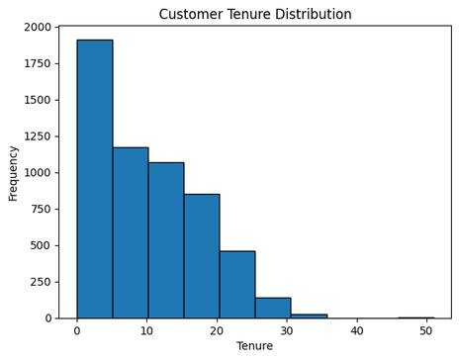
EDA
What We Discovered:
We found something interesting. Customers who've been with the company for a very short time, less than 2 units, tend to leave the service a lot. But, as customers stay with us longer, they're much less likely to leave.
What It Means:
This suggests that when customers stick around for a while, they're more likely to stay with us. So, building long-term relationships with customers is key to reducing the number of people who leave our service.
DAB303 – MARKETING ANALYTICS

Slide 8
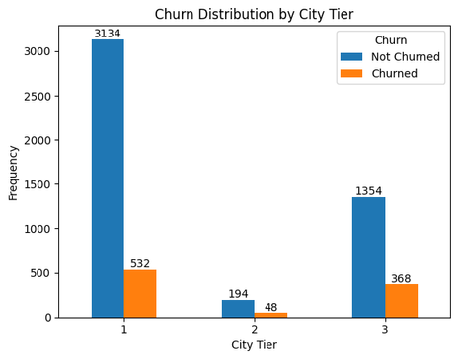
Churn Distribution by City Tier
What We Discovered:
In our analysis, we found that customers in tier 2 and tier 3 cities have a higher churn rate.
What It Means:
Higher churn in tier 2 and 3 cities suggests unique challenges. We must tailor strategies, understand their needs, and adjust services and marketing to improve retention.
DAB303 – MARKETING ANALYTICS
06

Slide 9
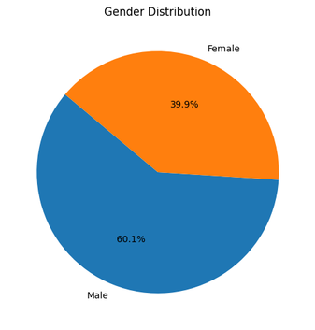
EDA
What We Discovered:
Among our app users, we noticed a significant 60.1% churn rate among male customers.
What We Will Do:
To address the high male customer churn rate, we'll investigate underlying reasons, develop male-focused products and services, and explore other contributing factors.
DAB303 – MARKETING ANALYTICS

Slide 10
EDA
What We Noticed:
We've spotted an important trend: when the number of customer complaints goes up, we also see a big increase in customer churn.
What We'll Do:
They have to swiftly resolve complaints and tackle underlying issues to ensure long-term customer satisfaction and retention.
DAB303 – MARKETING ANALYTICS
08

Slide 11
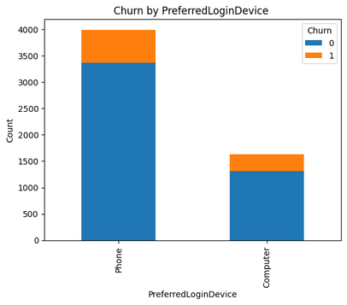
EDA
What We've Noticed:
We've observed that customers who mainly use our services on mobile phones are more likely to leave.
What We Will Do:
They need to improve the mobile app by analyzing usability, performance, and features to retain more users.
DAB303 – MARKETING ANALYTICS

Slide 12
EDA
What We Noticed:
We've spotted an important trend: when the number of customer complaints goes up, we also see a big increase in customer churn.
What We'll Do:
They have to swiftly resolve complaints and tackle underlying issues to ensure long-term customer satisfaction and retention.
DAB303 – MARKETING ANALYTICS
10

Slide 13
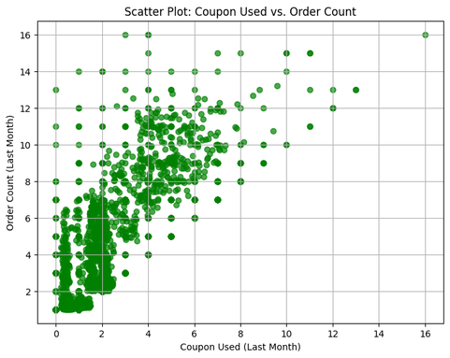
Coupon Used vs. Order Count
What We can Do:
Targeted coupon-based marketing can increase orders and engage customers, benefiting both customers and the company.
What We've Noticed:
Using more coupons is positively linked to higher order counts by customers.
DAB303 – MARKETING ANALYTICS

Slide 14
Recommendations & Conclusion
Customer churn analysis highlights key factors: complaints, tier 2 and 3 city residents, and male customers show higher churn rates.
Strategy should emphasize customer satisfaction - quick complaint resolution, tier-specific retention approaches, and initiatives for male customers.
Focusing efforts in these areas will reduce churn, boost customer retention, and lead to long-term company success.
DAB303 – MARKETING ANALYTICS
12

Slide 15
Thank
DAB303 – MARKETING ANALYTICS
you!
13

